Slide 1
Node.js
Notes:
A opensource, cross platform runtime environment for executing JavaScript code outside of a browser and it is not a framework.
it is used to built backend services for e.g. API(Application Program Interface)
Benefits:
Scalable
Agile
Large system of open-source libraries
Companies:
Pay-pal
Uber
Netflix
Walmart
JavaScript engine in:
microsoft edge: chakra
morzilla: SpiderMonkey
chrome: V8
In 2009, Ryan Dahl embeds chrome(V8) with c++ program called it (Node.exe)
(4:30 video)
Event Queue:
Node monitors the event queue, and check and handle that request. 9:20
Good for I/O intensive
We should be used to develop data intensive or real-time application
Not good for CPU intensive

Slide 2
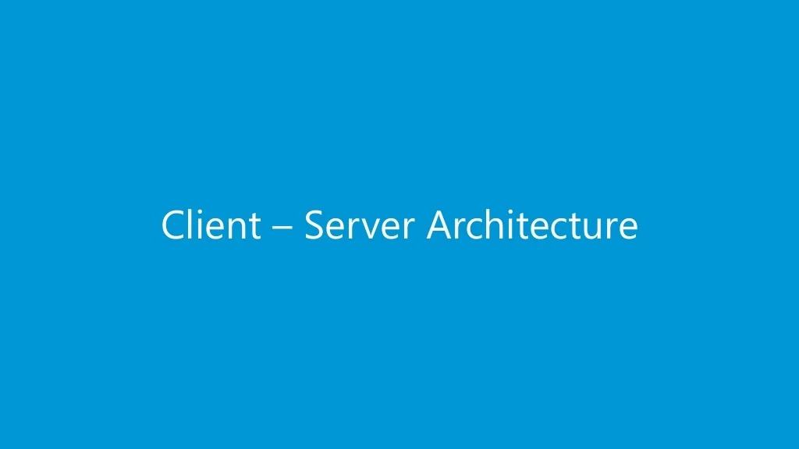

Slide 3
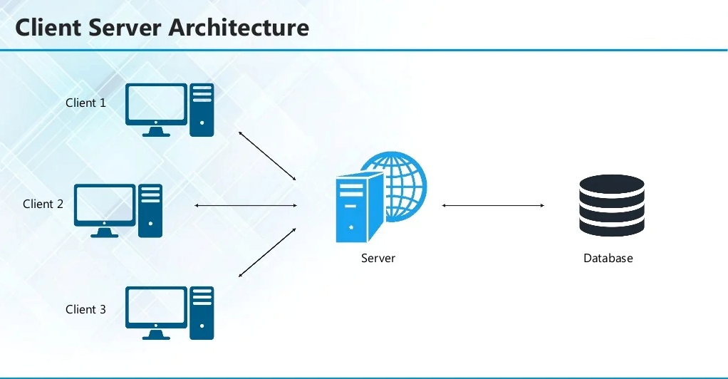

Slide 4
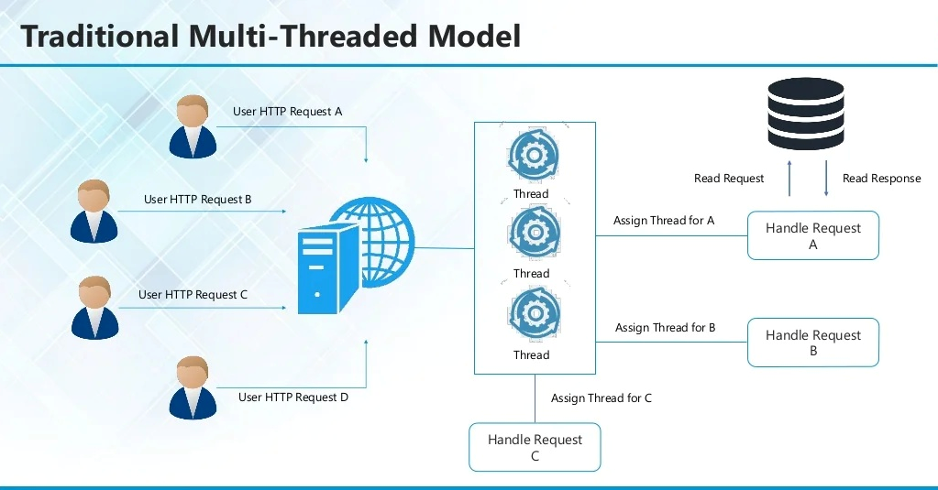

Slide 5
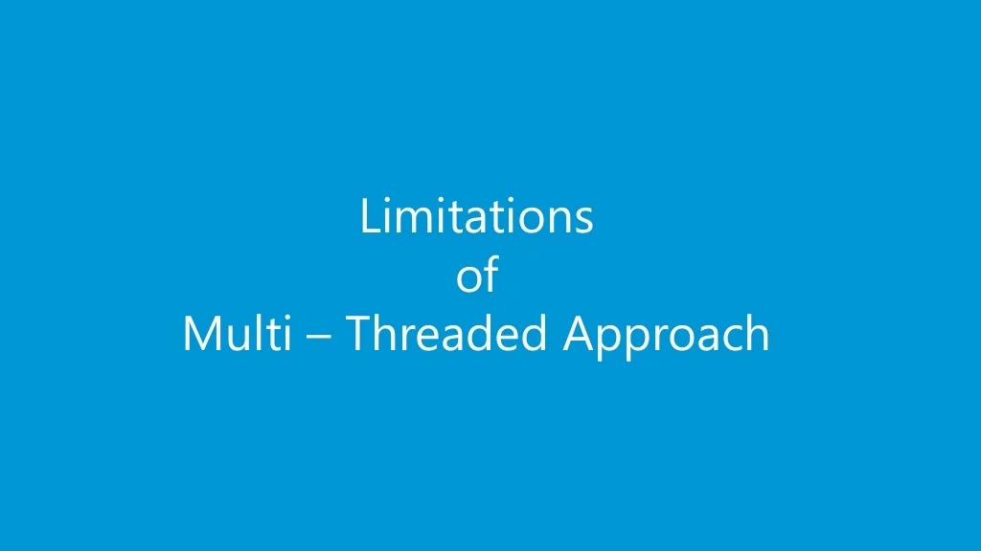

Slide 6
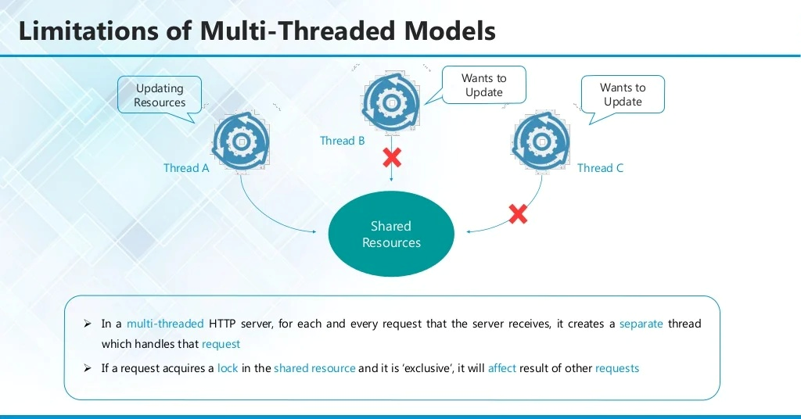

Slide 7
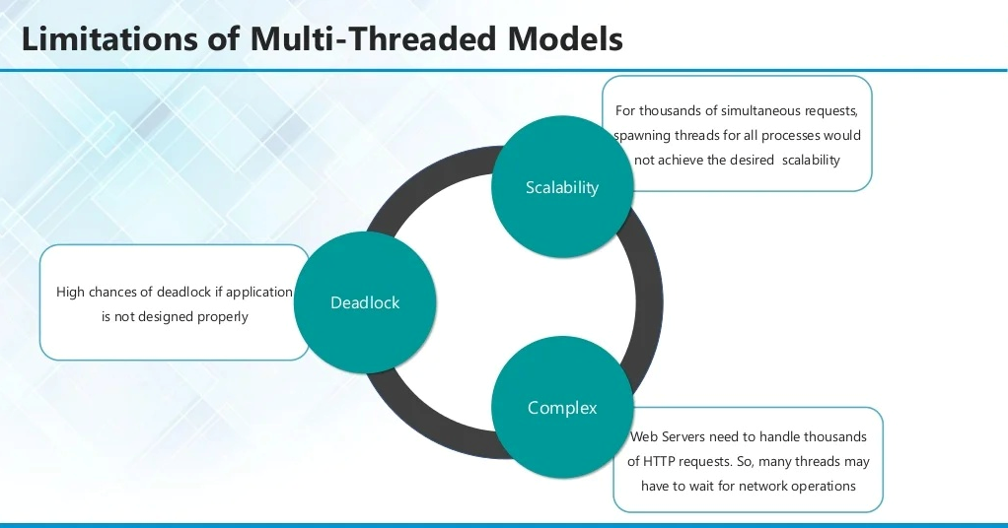

Slide 8
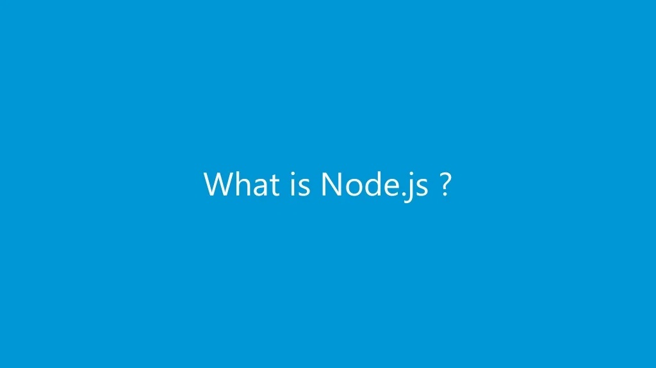

Slide 9
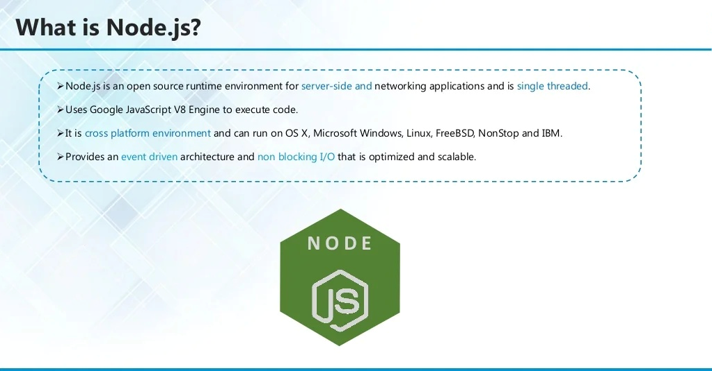

Slide 10
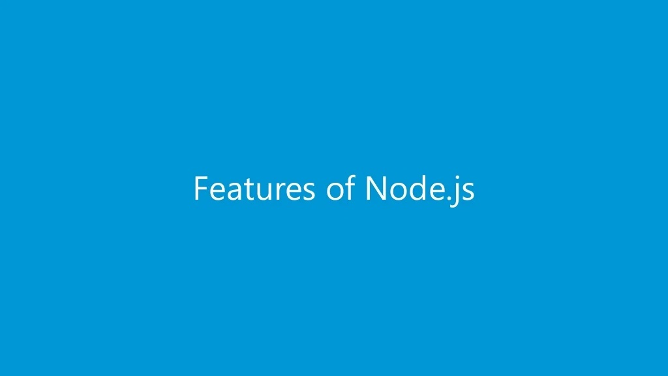

Slide 11
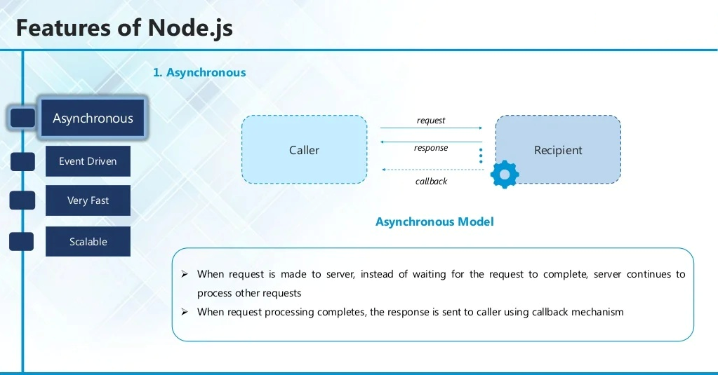

Slide 12
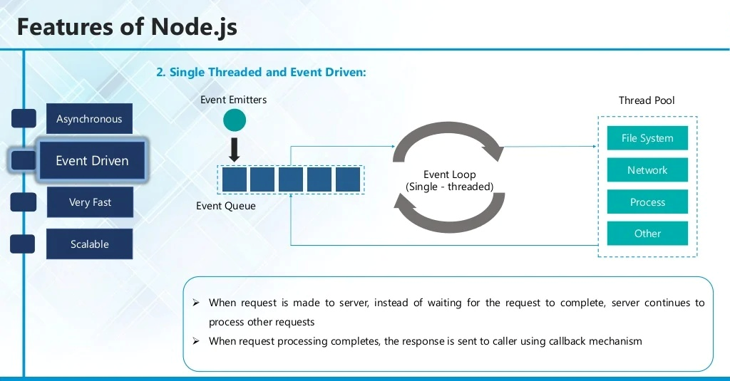

Slide 13
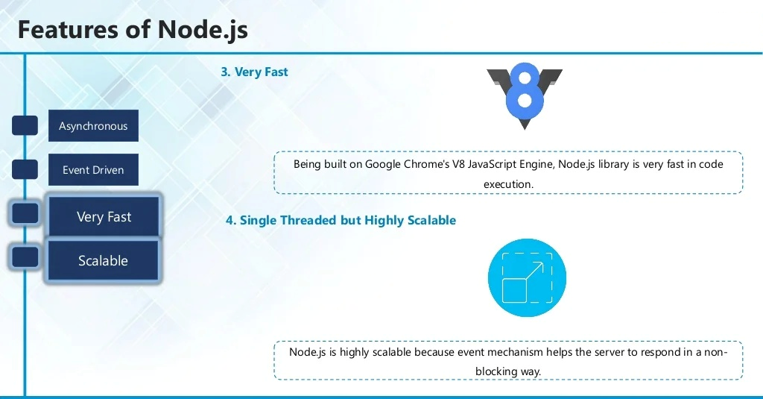

Slide 14
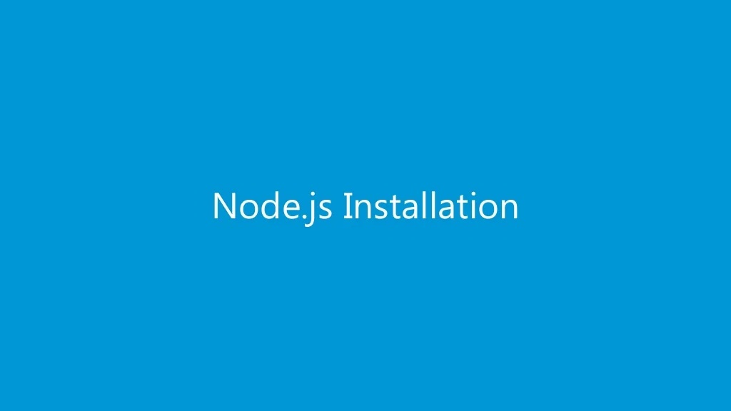

Slide 15
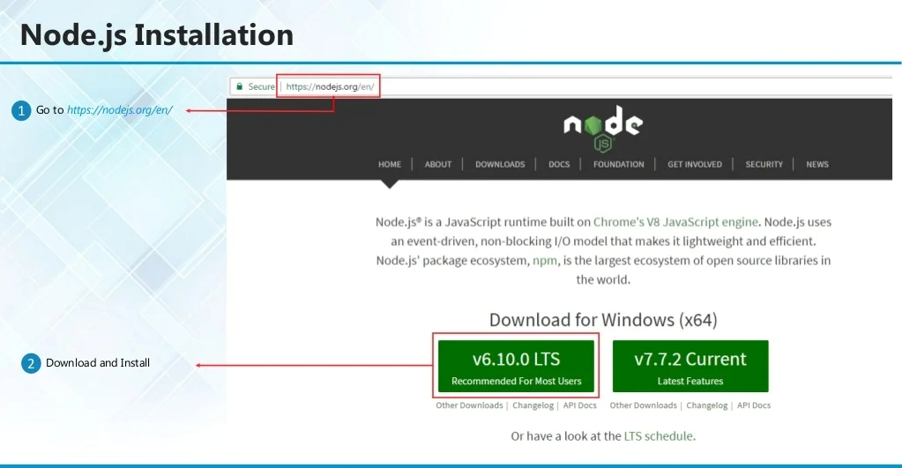

Slide 16
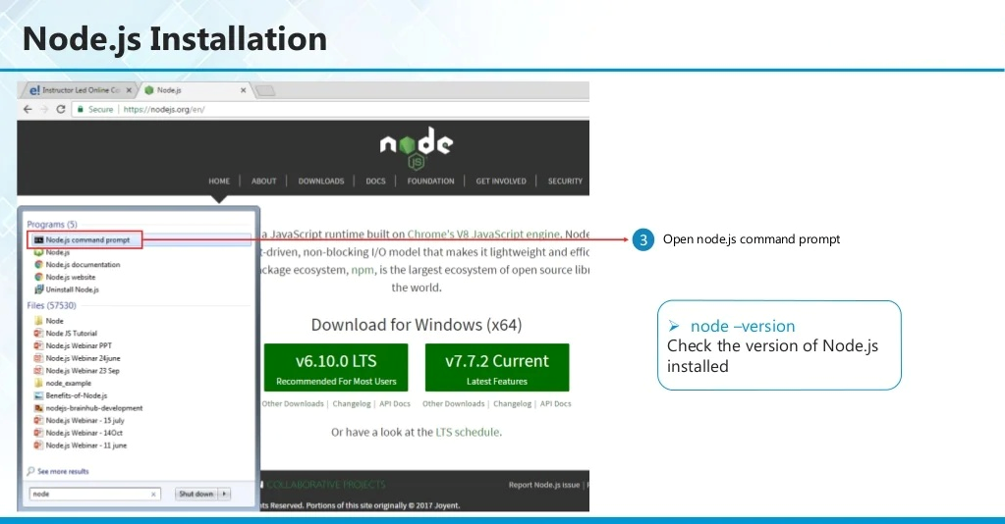

Slide 17
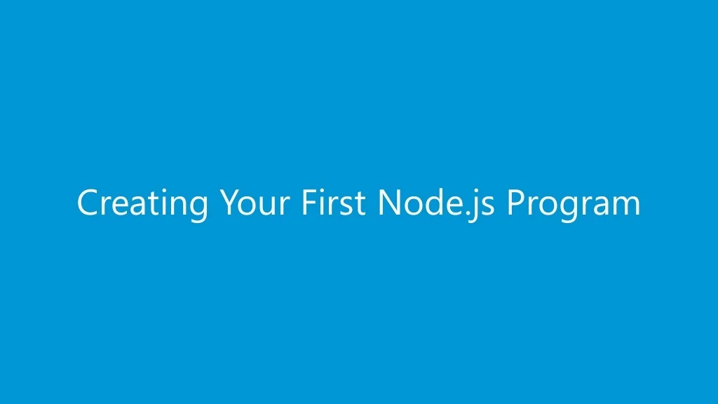

Slide 18
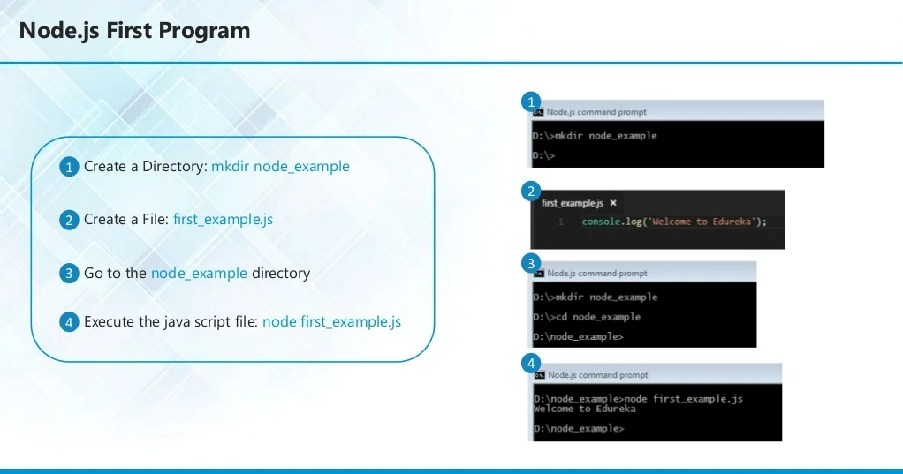

Slide 19
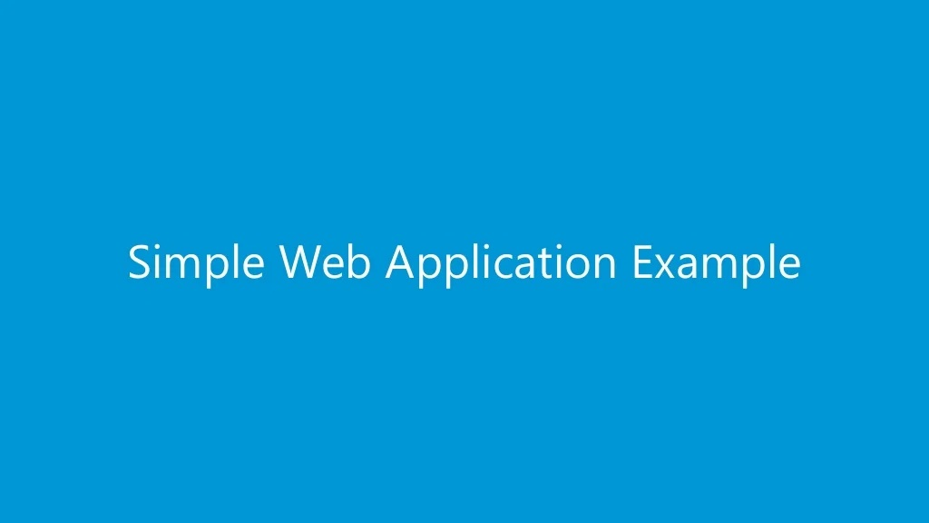

Slide 20
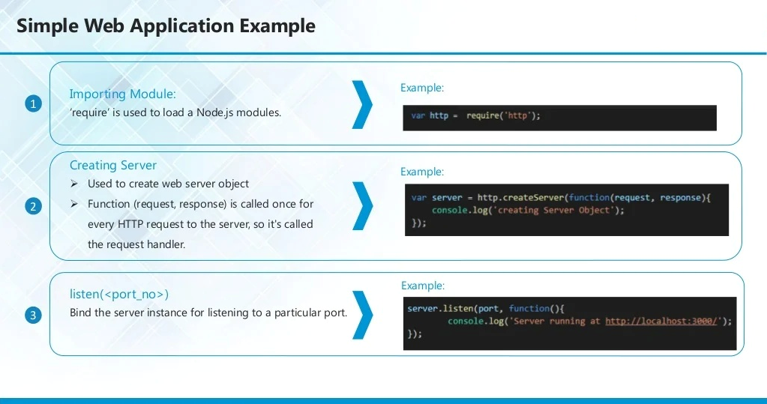

Slide 21
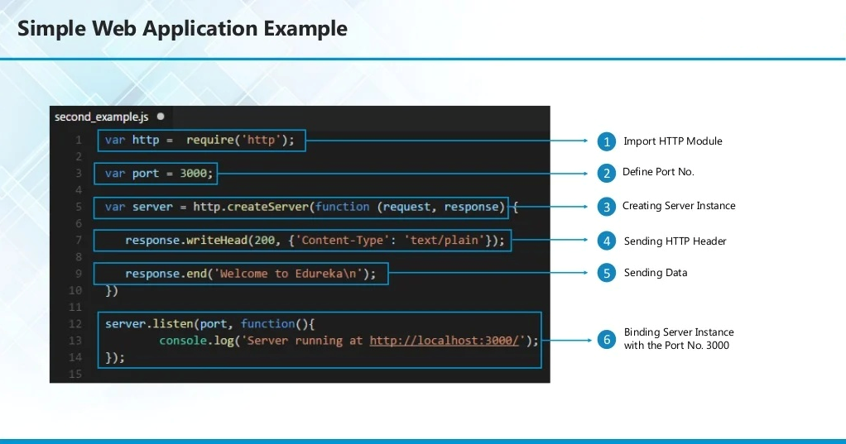

Slide 22
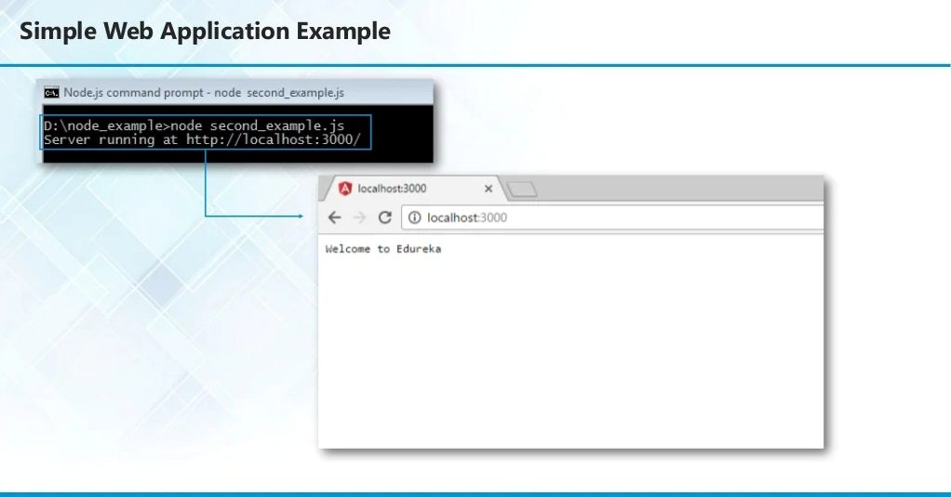

Slide 23
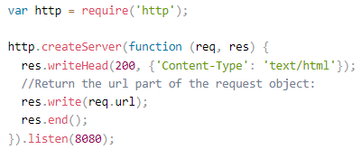
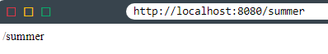
Read the Query String

Slide 24
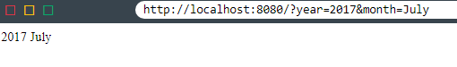
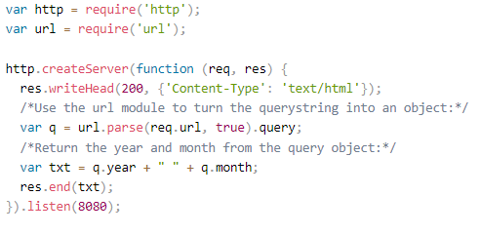
Split the Query String

Slide 25
Task
Add two numbers by parsing the query string by using node.js
Secondly, Same task should be done using ReactJS as front end and Node.js as backend (use query string).

